Slide 1
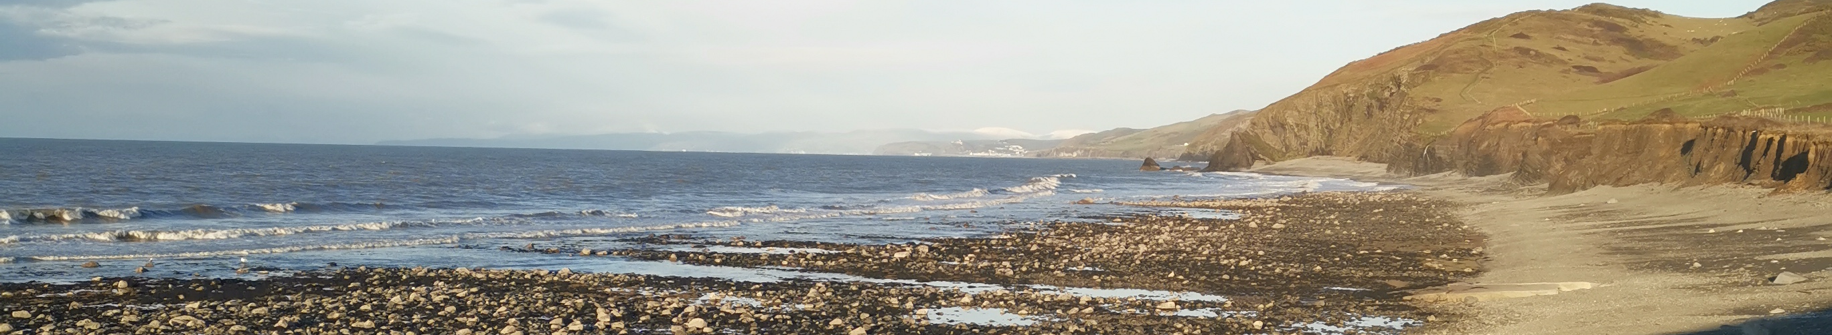
David Gethin Lewis
Full Stack Developer | Game Developer
@dgethinlewis@gmail.com
Home
Projects
About Me
I have used many different programming languages in my time at university and in my free time. Of all the programming languages I have used I am most comfortable using C#, HTML5, CSS and JavaScript. Using the previously mentioned programming languages, I completed a final year project at university which was creating a web-based game for young children to learn Welsh. I have also continued working on the game after university and I’m hoping to turn the game into an application in the near future. As a person I am very passionate about virtual reality and its possible uses in the future. I am also currently creating my own games in Unity using C#.

Slide 2
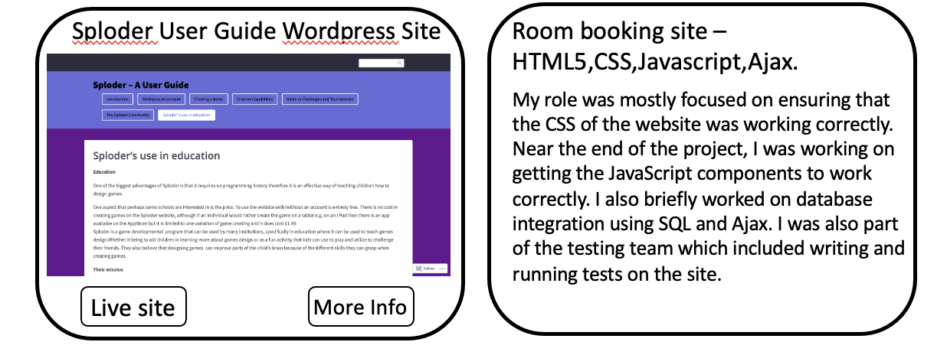
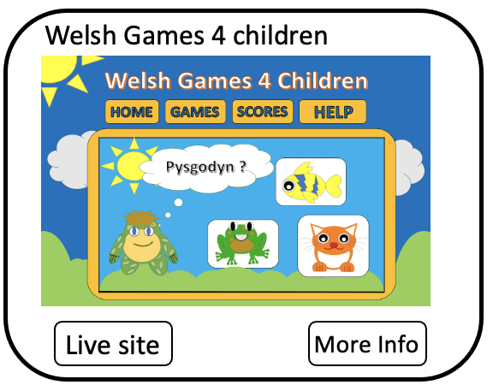
David Gethin Lewis
Full Stack Developer | Game Developer
@dgethinlewis@gmail.com
Home
Projects
About Me
Graduate projects

Slide 3
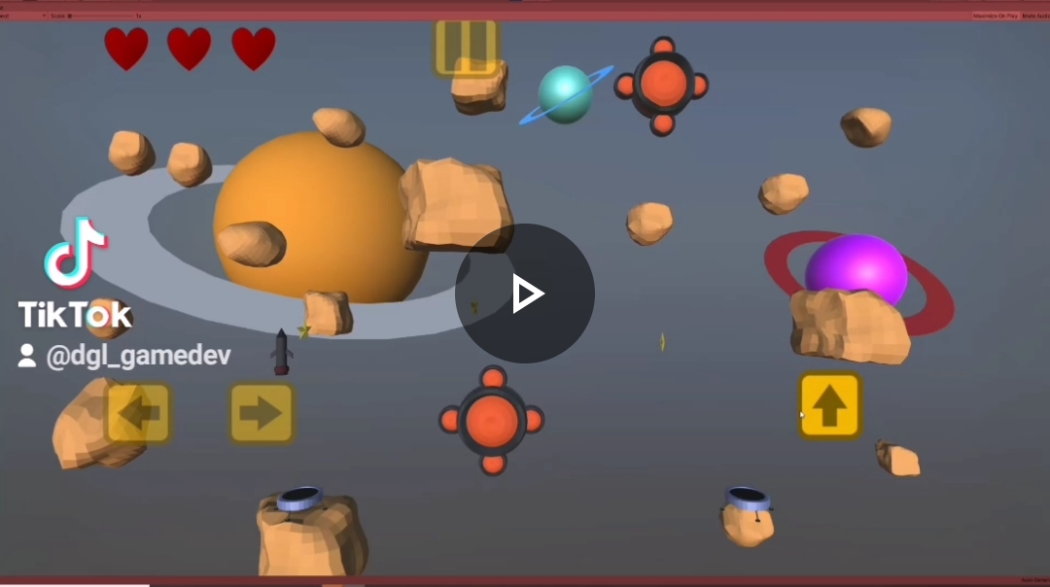
David Gethin Lewis
Full Stack Developer | Game Developer
@dgethinlewis@gmail.com
Home
Projects
About Me
Personal projects
Asteroid Void

Slide 4
David Gethin Lewis
Full Stack Developer | Game Developer
@dgethinlewis@gmail.com
Home
Projects
About Me
As I want to pursue a career in game development, after graduating in the first half of 2020, I started creating my own game/games. Screenshots of the game can be shown on the right. The aim of the game is to move the rocket from one side of the screen to the other. The game uses touch controls but also a keyboard and mouse which allows the game to be played on a mobile device or a computer. All assets visible in the game were created by me using blender. Project spd a game I created (include screenshots). The game is written in C#.

Slide 5
Days 1-6
Days 13-18
Days 7-12
Days 19-24

